Slide 1
Chapter 10 – Strings and Characters
Outline
10.1 Introduction
10.2 Fundamentals of Characters and Strings
10.3 String Constructors
10.4 String Methods length, charAt and getChars
10.5 Comparing Strings
10.6 String Method hashCode
10.7 Locating Characters and Substrings in Strings
10.8 Extracting Substrings from Strings
10.9 Concatenating Strings
10.10 Miscellaneous String Methods
10.11 Using String Method valueOf
10.12 String Method intern
10.13 StringBuffer Class
10.14 StringBuffer Constructors
10.15 StringBuffer Methods length, capacity, setLength and ensureCapacity

Slide 2
Chapter 10 – Strings and Characters
10.16 StringBuffer Methods charAt, setCharAt, getChars and reverse
10.17 StringBuffer append Methods
10.18 StringBuffer Insertion and Deletion Methods
10.19 Character Class Examples
10.20 Class StringTokenizer
10.21 Card Shuffling and Dealing Simulation
10.22 (Optional Case Study) Thinking About Objects: Event Handling

Slide 3
10.1 Introduction
String and character processing
  Class java.lang.String
  Class java.lang.StringBuffer
  Class java.lang.Character
  Class java.util.StringTokenizer

Slide 4
10.2 Fundamentals of Characters and Strings
Characters
  “Building blocks” of Java source programs
String
  Series of characters treated as single unit
  May include letters, digits, etc.
  Object of class String

Slide 5
10.3 String Constructors
Class String
  Provides nine constructors

Slide 6
StringConstructors.java
Line 25
Line 26
Line 27
Line 28
Line 29
Line 30
Line 31
1 // Fig. 10.1: StringConstructors.java
2 // This program demonstrates the String class constructors.
3
4 // Java extension packages
5 import javax.swing.*;
6
7 public class StringConstructors {
8
9 // test String constructors
10 public static void main( String args[] )
11 {
12 char charArray[] = { 'b', 'i', 'r', 't', 'h', ' ',
13 'd', 'a', 'y' };
14 byte byteArray[] = { ( byte ) 'n', ( byte ) 'e',
15 ( byte ) 'w', ( byte ) ' ', ( byte ) 'y',
16 ( byte ) 'e', ( byte ) 'a', ( byte ) 'r' };
17
18 StringBuffer buffer;
19 String s, s1, s2, s3, s4, s5, s6, s7, output;
20
21 s = new String( "hello" );
22 buffer = new StringBuffer( "Welcome to Java Programming!" );
23
24 // use String constructors
25 s1 = new String();
26 s2 = new String( s );
27 s3 = new String( charArray );
28 s4 = new String( charArray, 6, 3 );
29 s5 = new String( byteArray, 4, 4 );
30 s6 = new String( byteArray );
31 s7 = new String( buffer );
32
String default constructor instantiates empty string
Constructor copies String
Constructor copies character array
Constructor copies character-array subset
Constructor copies byte array
Constructor copies byte-array subset
Constructor copies StringBuffer

Slide 7
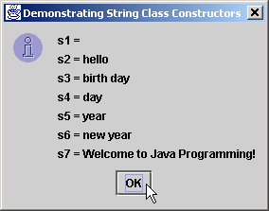
StringConstructors.java
33 // append Strings to output
34 output = "s1 = " + s1 + "\ns2 = " + s2 + "\ns3 = " + s3 +
35 "\ns4 = " + s4 + "\ns5 = " + s5 + "\ns6 = " + s6 +
36 "\ns7 = " + s7;
37
38 JOptionPane.showMessageDialog( null, output,
39 "Demonstrating String Class Constructors",
40 JOptionPane.INFORMATION_MESSAGE );
41
42 System.exit( 0 );
43 }
44
45 } // end class StringConstructors

Slide 8
10.4 String Methods length, charAt and getChars
Method length
  Determine String length
    Like arrays, Strings always “know” their size
    Unlike array, Strings do not have length instance variable
Method charAt
  Get character at specific location in String
Method getChars
  Get entire set of characters in String

Slide 9
StringMiscellaneous.java
Line 28
Line 33
1 // Fig. 10.2: StringMiscellaneous.java
2 // This program demonstrates the length, charAt and getChars
3 // methods of the String class.
4 //
5 // Note: Method getChars requires a starting point
6 // and ending point in the String. The starting point is the
7 // actual subscript from which copying starts. The ending point
8 // is one past the subscript at which the copying ends.
9
10 // Java extension packages
11 import javax.swing.*;
12
13 public class StringMiscellaneous {
14
15 // test miscellaneous String methods
16 public static void main( String args[] )
17 {
18 String s1, output;
19 char charArray[];
20
21 s1 = new String( "hello there" );
22 charArray = new char[ 5 ];
23
24 // output the string
25 output = "s1: " + s1;
26
27 // test length method
28 output += "\nLength of s1: " + s1.length();
29
30 // loop through characters in s1 and display reversed
31 output += "\nThe string reversed is: ";
32
33 for ( int count = s1.length() - 1; count >= 0; count-- )
34 output += s1.charAt( count ) + " ";
35
Determine number of characters in String s1
Append s1’s characters in reverse order to String output

Slide 10
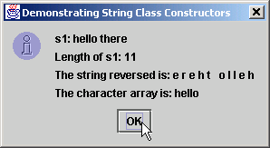
StringMiscellaneous.java
Line 37
36 // copy characters from string into char array
37 s1.getChars( 0, 5, charArray, 0 );
38 output += "\nThe character array is: ";
39
40 for ( int count = 0; count < charArray.length; count++ )
41 output += charArray[ count ];
42
43 JOptionPane.showMessageDialog( null, output,
44 "Demonstrating String Class Constructors",
45 JOptionPane.INFORMATION_MESSAGE );
46
47 System.exit( 0 );
48 }
49
50 } // end class StringMiscellaneous
Copy (some of) s1’s characters to charArray

Slide 11
10.5 Comparing Strings
Comparing String objects
  Method equals
  Method equalsIgnoreCase
  Method compareTo
  Method regionMatches

Slide 12
StringCompare.java
Line 25
Line 31
1 // Fig. 10.3: StringCompare.java
2 // This program demonstrates the methods equals,
3 // equalsIgnoreCase, compareTo, and regionMatches
4 // of the String class.
5
6 // Java extension packages
7 import javax.swing.JOptionPane;
8
9 public class StringCompare {
10
11 // test String class comparison methods
12 public static void main( String args[] )
13 {
14 String s1, s2, s3, s4, output;
15
16 s1 = new String( "hello" );
17 s2 = new String( "good bye" );
18 s3 = new String( "Happy Birthday" );
19 s4 = new String( "happy birthday" );
20
21 output = "s1 = " + s1 + "\ns2 = " + s2 +
22 "\ns3 = " + s3 + "\ns4 = " + s4 + "\n\n";
23
24 // test for equality
25 if ( s1.equals( "hello" ) )
26 output += "s1 equals \"hello\"\n";
27 else
28 output += "s1 does not equal \"hello\"\n";
29
30 // test for equality with ==
31 if ( s1 == "hello" )
32 output += "s1 equals \"hello\"\n";
33 else
34 output += "s1 does not equal \"hello\"\n";
35
Method equals tests two objects for equality using lexicographical comparison
Equality operator (==) tests if both references refer to same object in memory

Slide 13
StringCompare.java
Line 37
Lines 44-48
Line 52 and 59
Test two objects for equality, but ignore case of letters in String
36 // test for equality (ignore case)
37 if ( s3.equalsIgnoreCase( s4 ) )
38 output += "s3 equals s4\n";
39 else
40 output += "s3 does not equal s4\n";
41
42 // test compareTo
43 output +=
44 "\ns1.compareTo( s2 ) is " + s1.compareTo( s2 ) +
45 "\ns2.compareTo( s1 ) is " + s2.compareTo( s1 ) +
46 "\ns1.compareTo( s1 ) is " + s1.compareTo( s1 ) +
47 "\ns3.compareTo( s4 ) is " + s3.compareTo( s4 ) +
48 "\ns4.compareTo( s3 ) is " + s4.compareTo( s3 ) +
49 "\n\n";
50
51 // test regionMatches (case sensitive)
52 if ( s3.regionMatches( 0, s4, 0, 5 ) )
53 output += "First 5 characters of s3 and s4 match\n";
54 else
55 output +=
56 "First 5 characters of s3 and s4 do not match\n";
57
58 // test regionMatches (ignore case)
59 if ( s3.regionMatches( true, 0, s4, 0, 5 ) )
60 output += "First 5 characters of s3 and s4 match";
61 else
62 output +=
63 "First 5 characters of s3 and s4 do not match";
64
Method compareTo compares String objects
Method regionMatches compares portions of two String objects for equality

Slide 14
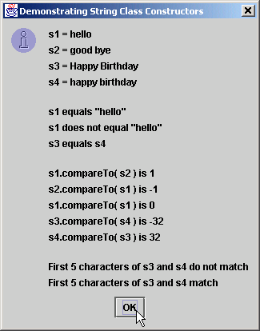
StringCompare.java
65 JOptionPane.showMessageDialog( null, output,
66 "Demonstrating String Class Constructors",
67 JOptionPane.INFORMATION_MESSAGE );
68
69 System.exit( 0 );
70 }
71
72 } // end class StringCompare

Slide 15
StringStartEnd.java
Line 21
Line 31
1 // Fig. 10.4: StringStartEnd.java
2 // This program demonstrates the methods startsWith and
3 // endsWith of the String class.
4
5 // Java extension packages
6 import javax.swing.*;
7
8 public class StringStartEnd {
9
10 // test String comparison methods for beginning and end
11 // of a String
12 public static void main( String args[] )
13 {
14 String strings[] =
15 { "started", "starting", "ended", "ending" };
16 String output = "";
17
18 // test method startsWith
19 for ( int count = 0; count < strings.length; count++ )
20
21 if ( strings[ count ].startsWith( "st" ) )
22 output += "\"" + strings[ count ] +
23 "\" starts with \"st\"\n";
24
25 output += "\n";
26
27 // test method startsWith starting from position
28 // 2 of the string
29 for ( int count = 0; count < strings.length; count++ )
30
31 if ( strings[ count ].startsWith( "art", 2 ) )
32 output += "\"" + strings[ count ] +
33 "\" starts with \"art\" at position 2\n";
34
35 output += "\n";
Method startsWith determines if String starts with specified characters

Slide 16
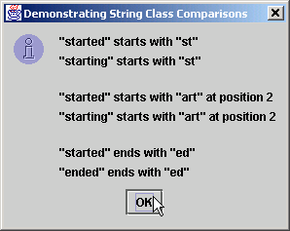
StringStartEnd.java
Line 40
36
37 // test method endsWith
38 for ( int count = 0; count < strings.length; count++ )
39
40 if ( strings[ count ].endsWith( "ed" ) )
41 output += "\"" + strings[ count ] +
42 "\" ends with \"ed\"\n";
43
44 JOptionPane.showMessageDialog( null, output,
45 "Demonstrating String Class Comparisons",
46 JOptionPane.INFORMATION_MESSAGE );
47
48 System.exit( 0 );
49 }
50
51 } // end class StringStartEnd
Method endsWith determines if String ends with specified characters

Slide 17
10.6 String Method hashCode
Hash table
  Stores information using calculation on storable object
    Produces hash code
      Used to choose location in table at which to store object
  Fast lookup

Slide 18
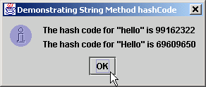
StringHashCode.java
Line 17 and 19
1 // Fig. 10.5: StringHashCode.java
2 // This program demonstrates the method
3 // hashCode of the String class.
4
5 // Java extension packages
6 import javax.swing.*;
7
8 public class StringHashCode {
9
10 // test String hashCode method
11 public static void main( String args[] )
12 {
13 String s1 = "hello", s2 = "Hello";
14
15 String output =
16 "The hash code for \"" + s1 + "\" is " +
17 s1.hashCode() +
18 "\nThe hash code for \"" + s2 + "\" is " +
19 s2.hashCode();
20
21 JOptionPane.showMessageDialog( null, output,
22 "Demonstrating String Method hashCode",
23 JOptionPane.INFORMATION_MESSAGE );
24
25 System.exit( 0 );
26 }
27
28 } // end class StringHashCode
Method hashCode performs hash-code calculation

Slide 19
10.7 Locating Characters and Substrings in Strings
Search for characters in String
  Method indexOf
  Method lastIndexOf

Slide 20
StringIndexMethods.java
Lines 16-23
Lines 26-33
1 // Fig. 10.6: StringIndexMethods.java
2 // This program demonstrates the String
3 // class index methods.
4
5 // Java extension packages
6 import javax.swing.*;
7
8 public class StringIndexMethods {
9
10 // String searching methods
11 public static void main( String args[] )
12 {
13 String letters = "abcdefghijklmabcdefghijklm";
14
15 // test indexOf to locate a character in a string
16 String output = "'c' is located at index " +
17 letters.indexOf( 'c' );
18
19 output += "\n'a' is located at index " +
20 letters.indexOf( 'a', 1 );
21
22 output += "\n'$' is located at index " +
23 letters.indexOf( '$' );
24
25 // test lastIndexOf to find a character in a string
26 output += "\n\nLast 'c' is located at index " +
27 letters.lastIndexOf( 'c' );
28
29 output += "\nLast 'a' is located at index " +
30 letters.lastIndexOf( 'a', 25 );
31
32 output += "\nLast '$' is located at index " +
33 letters.lastIndexOf( '$' );
34
Method indexOf finds first occurrence of character in String
Method lastIndexOf finds last occurrence of character in String

Slide 21
StringIndexMethods.java
35 // test indexOf to locate a substring in a string
36 output += "\n\n\"def\" is located at index " +
37 letters.indexOf( "def" );
38
39 output += "\n\"def\" is located at index " +
40 letters.indexOf( "def", 7 );
41
42 output += "\n\"hello\" is located at index " +
43 letters.indexOf( "hello" );
44
45 // test lastIndexOf to find a substring in a string
46 output += "\n\nLast \"def\" is located at index " +
47 letters.lastIndexOf( "def" );
48
49 output += "\nLast \"def\" is located at index " +
50 letters.lastIndexOf( "def", 25 );
51
52 output += "\nLast \"hello\" is located at index " +
53 letters.lastIndexOf( "hello" );
54
55 JOptionPane.showMessageDialog( null, output,
56 "Demonstrating String Class \"index\" Methods",
57 JOptionPane.INFORMATION_MESSAGE );
58
59 System.exit( 0 );
60 }
61
62 } // end class StringIndexMethods
Methods indexOf and lastIndexOf can also find occurrences of substrings

Slide 22
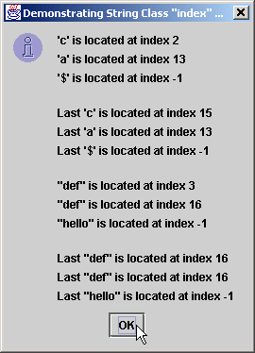
StringIndexMethods.java

Slide 23
10.8 Extracting Substrings from Strings
Create Strings from other Strings
  Extract substrings

Slide 24
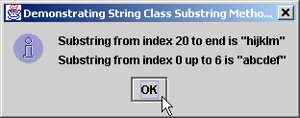
SubString.java
Line 17
Line 20
1 // Fig. 10.7: SubString.java
2 // This program demonstrates the
3 // String class substring methods.
4
5 // Java extension packages
6 import javax.swing.*;
7
8 public class SubString {
9
10 // test String substring methods
11 public static void main( String args[] )
12 {
13 String letters = "abcdefghijklmabcdefghijklm";
14
15 // test substring methods
16 String output = "Substring from index 20 to end is " +
17 "\"" + letters.substring( 20 ) + "\"\n";
18
19 output += "Substring from index 0 up to 6 is " +
20 "\"" + letters.substring( 0, 6 ) + "\"";
21
22 JOptionPane.showMessageDialog( null, output,
23 "Demonstrating String Class Substring Methods",
24 JOptionPane.INFORMATION_MESSAGE );
25
26 System.exit( 0 );
27 }
28
29 } // end class SubString
Beginning at index 20, extract characters from String letters
Extract characters from index 0 to 6 from String letters

Slide 25
10.9 Concatenating Strings
Method concat
  Concatenate two String objects

Slide 26
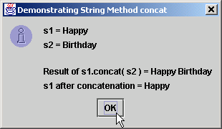
StringConcatenation.java
Line 20
Line 22
1 // Fig. 10.8: StringConcatenation.java
2 // This program demonstrates the String class concat method.
3 // Note that the concat method returns a new String object. It
4 // does not modify the object that invoked the concat method.
5
6 // Java extension packages
7 import javax.swing.*;
8
9 public class StringConcatenation {
10
11 // test String method concat
12 public static void main( String args[] )
13 {
14 String s1 = new String( "Happy " ),
15 s2 = new String( "Birthday" );
16
17 String output = "s1 = " + s1 + "\ns2 = " + s2;
18
19 output += "\n\nResult of s1.concat( s2 ) = " +
20 s1.concat( s2 );
21
22 output += "\ns1 after concatenation = " + s1;
23
24 JOptionPane.showMessageDialog( null, output,
25 "Demonstrating String Method concat",
26 JOptionPane.INFORMATION_MESSAGE );
27
28 System.exit( 0 );
29 }
30
31 } // end class StringConcatenation
Concatenate String s2 to String s1
However, String s1 is not modified by method concat

Slide 27
10.10 Miscellaneous String Methods
Miscellaneous String methods
  Return modified copies of String
  Return character array

Slide 28
StringMiscellaneous2.java
Line 22
Line 26
Line 27
Line 30
Line 33
1 // Fig. 10.9: StringMiscellaneous2.java
2 // This program demonstrates the String methods replace,
3 // toLowerCase, toUpperCase, trim, toString and toCharArray
4
5 // Java extension packages
6 import javax.swing.*;
7
8 public class StringMiscellaneous2 {
9
10 // test miscellaneous String methods
11 public static void main( String args[] )
12 {
13 String s1 = new String( "hello" ),
14 s2 = new String( "GOOD BYE" ),
15 s3 = new String( " spaces " );
16
17 String output = "s1 = " + s1 + "\ns2 = " + s2 +
18 "\ns3 = " + s3;
19
20 // test method replace
21 output += "\n\nReplace 'l' with 'L' in s1: " +
22 s1.replace( 'l', 'L' );
23
24 // test toLowerCase and toUpperCase
25 output +=
26 "\n\ns1.toUpperCase() = " + s1.toUpperCase() +
27 "\ns2.toLowerCase() = " + s2.toLowerCase();
28
29 // test trim method
30 output += "\n\ns3 after trim = \"" + s3.trim() + "\"";
31
32 // test toString method
33 output += "\n\ns1 = " + s1.toString();
34
Use method replace to return s1 copy in which every occurrence of ‘l’ is replaced with ‘L’
Use method toUpperCase to return s1 copy in which every character is uppercase
Use method toLowerCase to return s2 copy in which every character is uppercase
Use method trim to return s3 copy in which whitespace is eliminated
Use method toString to return s1

Slide 29
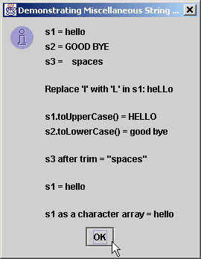
StringMiscellaneous2.java
Line 36
35 // test toCharArray method
36 char charArray[] = s1.toCharArray();
37
38 output += "\n\ns1 as a character array = ";
39
40 for ( int count = 0; count < charArray.length; ++count )
41 output += charArray[ count ];
42
43 JOptionPane.showMessageDialog( null, output,
44 "Demonstrating Miscellaneous String Methods",
45 JOptionPane.INFORMATION_MESSAGE );
46
47 System.exit( 0 );
48 }
49
50 } // end class StringMiscellaneous2
Use method toCharArray to return character array of s1

Slide 30
10.11 Using String Method valueOf
String provides static class methods
  Method valueOf
    Returns String representation of object, data type, etc.

Slide 31
StringValueOf.java
Lines 26-32
1 // Fig. 10.10: StringValueOf.java
2 // This program demonstrates the String class valueOf methods.
3
4 // Java extension packages
5 import javax.swing.*;
6
7 public class StringValueOf {
8
9 // test String valueOf methods
10 public static void main( String args[] )
11 {
12 char charArray[] = { 'a', 'b', 'c', 'd', 'e', 'f' };
13 boolean b = true;
14 char c = 'Z';
15 int i = 7;
16 long l = 10000000;
17 float f = 2.5f;
18 double d = 33.333;
19
20 Object o = "hello"; // assign to an Object reference
21 String output;
22
23 output = "char array = " + String.valueOf( charArray ) +
24 "\npart of char array = " +
25 String.valueOf( charArray, 3, 3 ) +
26 "\nboolean = " + String.valueOf( b ) +
27 "\nchar = " + String.valueOf( c ) +
28 "\nint = " + String.valueOf( i ) +
29 "\nlong = " + String.valueOf( l ) +
30 "\nfloat = " + String.valueOf( f ) +
31 "\ndouble = " + String.valueOf( d ) +
32 "\nObject = " + String.valueOf( o );
33
static method valueOf of class String returns String representation of various types

Slide 32
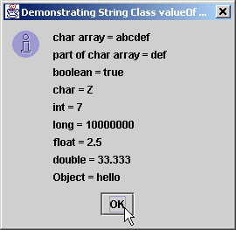
StringValueOf.java
34 JOptionPane.showMessageDialog( null, output,
35 "Demonstrating String Class valueOf Methods",
36 JOptionPane.INFORMATION_MESSAGE );
37
38 System.exit( 0 );
39 }
40
41 } // end class StringValueOf

Slide 33
10.12 String Method intern
String comparisons
  Slow operation
  Method intern improves this performance
    Returns reference to String
    Guarantees reference has same contents as original String

Slide 34
StringIntern.java
Lines 15-20
Line 26
Lines 33-34
1 // Fig. 10.11: StringIntern.java
2 // This program demonstrates the intern method
3 // of the String class.
4
5 // Java extension packages
6 import javax.swing.*;
7
8 public class StringIntern {
9
10 // test String method intern
11 public static void main( String args[] )
12 {
13 String s1, s2, s3, s4, output;
14
15 s1 = new String( "hello" );
16 s2 = new String( "hello" );
17
18 // test strings to determine if they are same
19 // String object in memory
20 if ( s1 == s2 )
21 output = "s1 and s2 are the same object in memory";
22 else
23 output = "s1 and s2 are not the same object in memory";
24
25 // test strings for equality of contents
26 if ( s1.equals( s2 ) )
27 output += "\ns1 and s2 are equal";
28 else
29 output += "\ns1 and s2 are not equal";
30
31 // use String intern method to get a unique copy of
32 // "hello" referred to by both s3 and s4
33 s3 = s1.intern();
34 s4 = s2.intern();
35
String s1 and String s2 occupy different memory locations
String s1 and String s2 have same content
Reference returned by s1.intern() is same as that returned by s2.intern()

Slide 35
StringIntern.java
36 // test strings to determine if they are same
37 // String object in memory
38 if ( s3 == s4 )
39 output += "\ns3 and s4 are the same object in memory";
40 else
41 output +=
42 "\ns3 and s4 are not the same object in memory";
43
44 // determine if s1 and s3 refer to same object
45 if ( s1 == s3 )
46 output +=
47 "\ns1 and s3 are the same object in memory";
48 else
49 output +=
50 "\ns1 and s3 are not the same object in memory";
51
52 // determine if s2 and s4 refer to same object
53 if ( s2 == s4 )
54 output += "\ns2 and s4 are the same object in memory";
55 else
56 output +=
57 "\ns2 and s4 are not the same object in memory";
58
59 // determine if s1 and s4 refer to same object
60 if ( s1 == s4 )
61 output += "\ns1 and s4 are the same object in memory";
62 else
63 output +=
64 "\ns1 and s4 are not the same object in memory";
65

Slide 36
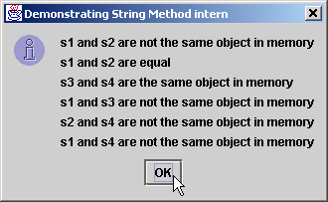
StringIntern.java
66 JOptionPane.showMessageDialog( null, output,
67 "Demonstrating String Method intern",
68 JOptionPane.INFORMATION_MESSAGE );
69
70 System.exit( 0 );
71 }
72
73 } // end class StringIntern

Slide 37
10.13 StringBuffer Class
Class StringBuffer
  When String object is created, its contents cannot change
  Used for creating and manipulating dynamic string data
    i.e., modifiable Strings
  Can store characters based on capacity
    Capacity expands dynamically to handle additional characters
  Uses operators + and += for String concatenation

Slide 38
10.14 StringBuffer Constructors
Three StringBuffer constructors
  Default creates StringBuffer with no characters
    Capacity of 16 characters

Slide 39
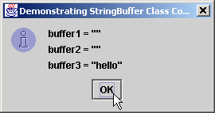
StringBufferConstructors.java
Line 14
Line 15
Line 16
Lines 19-21
1 // Fig. 10.12: StringBufferConstructors.java
2 // This program demonstrates the StringBuffer constructors.
3
4 // Java extension packages
5 import javax.swing.*;
6
7 public class StringBufferConstructors {
8
9 // test StringBuffer constructors
10 public static void main( String args[] )
11 {
12 StringBuffer buffer1, buffer2, buffer3;
13
14 buffer1 = new StringBuffer();
15 buffer2 = new StringBuffer( 10 );
16 buffer3 = new StringBuffer( "hello" );
17
18 String output =
19 "buffer1 = \"" + buffer1.toString() + "\"" +
20 "\nbuffer2 = \"" + buffer2.toString() + "\"" +
21 "\nbuffer3 = \"" + buffer3.toString() + "\"";
22
23 JOptionPane.showMessageDialog( null, output,
24 "Demonstrating StringBuffer Class Constructors",
25 JOptionPane.INFORMATION_MESSAGE );
26
27 System.exit( 0 );
28 }
29
30 } // end class StringBufferConstructors
Default constructor creates empty StringBuffer with capacity of 16 characters
Second constructor creates empty StringBuffer with capacity of specified (10) characters
Third constructor creates StringBuffer with String “hello” and capacity of 16 characters
Method toString returns String representation of StringBuffer

Slide 40
10.15 StringBuffer Methods length, capacity, setLength and ensureCapacity
Method length
  Return StringBuffer length
Method capacity
  Return StringBuffer capacity
Method setLength
  Increase or decrease StringBuffer length
Method ensureCapacity
  Set StringBuffer capacity
  Guarantee that StringBuffer has minimum capacity

Slide 41
StringBufferCapLen.java
Line 17
Line 18
Line 20
Line 23
1 // Fig. 10.13: StringBufferCapLen.java
2 // This program demonstrates the length and
3 // capacity methods of the StringBuffer class.
4
5 // Java extension packages
6 import javax.swing.*;
7
8 public class StringBufferCapLen {
9
10 // test StringBuffer methods for capacity and length
11 public static void main( String args[] )
12 {
13 StringBuffer buffer =
14 new StringBuffer( "Hello, how are you?" );
15
16 String output = "buffer = " + buffer.toString() +
17 "\nlength = " + buffer.length() +
18 "\ncapacity = " + buffer.capacity();
19
20 buffer.ensureCapacity( 75 );
21 output += "\n\nNew capacity = " + buffer.capacity();
22
23 buffer.setLength( 10 );
24 output += "\n\nNew length = " + buffer.length() +
25 "\nbuf = " + buffer.toString();
26
27 JOptionPane.showMessageDialog( null, output,
28 "StringBuffer length and capacity Methods",
29 JOptionPane.INFORMATION_MESSAGE );
30
31 System.exit( 0 );
32 }
33
34 } // end class StringBufferCapLen
Method length returns StringBuffer length
Method capacity returns StringBuffer capacity
Use method ensureCapacity to set capacity to 75
Use method setLength to set length to 10

Slide 42
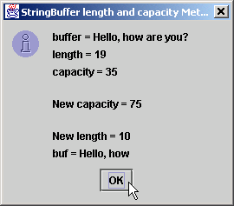
StringBufferCapLen.java
Only 10 characters from StringBuffer are printed
Only 10 characters from StringBuffer are printed

Slide 43
10.16 StringBuffer Methods charAt, setCharAt, getChars and reverse
Manipulating StringBuffer characters
  Method charAt
    Return StringBuffer character at specified index
  Method setCharAt
    Set StringBuffer character at specified index
  Method getChars
    Return character array from StringBuffer
  Method reverse
    Reverse StringBuffer contents

Slide 44
StringBufferChars.java
Lines 16-17
Line 20
Lines 26-27
Line 30
1 // Fig. 10.14: StringBufferChars.java
2 // The charAt, setCharAt, getChars, and reverse methods
3 // of class StringBuffer.
4
5 // Java extension packages
6 import javax.swing.*;
7
8 public class StringBufferChars {
9
10 // test StringBuffer character methods
11 public static void main( String args[] )
12 {
13 StringBuffer buffer = new StringBuffer( "hello there" );
14
15 String output = "buffer = " + buffer.toString() +
16 "\nCharacter at 0: " + buffer.charAt( 0 ) +
17 "\nCharacter at 4: " + buffer.charAt( 4 );
18
19 char charArray[] = new char[ buffer.length() ];
20 buffer.getChars( 0, buffer.length(), charArray, 0 );
21 output += "\n\nThe characters are: ";
22
23 for ( int count = 0; count < charArray.length; ++count )
24 output += charArray[ count ];
25
26 buffer.setCharAt( 0, 'H' );
27 buffer.setCharAt( 6, 'T' );
28 output += "\n\nbuf = " + buffer.toString();
29
30 buffer.reverse();
31 output += "\n\nbuf = " + buffer.toString();
32
Return StringBuffer characters at indices 0 and 4, respectively
Return character array from StringBuffer
Replace characters at indices 0 and 6 with ‘H’ and ‘T,’ respectively
Reverse characters in StringBuffer

Slide 45
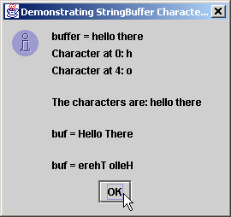
StringBufferChars.java
33 JOptionPane.showMessageDialog( null, output,
34 "Demonstrating StringBuffer Character Methods",
35 JOptionPane.INFORMATION_MESSAGE );
36
37 System.exit( 0 );
38 }
39
40 } // end class StringBufferChars

Slide 46
10.17 StringBuffer append Methods
Method append
  Allow data-type values to be added to StringBuffer

Slide 47
StringBufferAppend.java
Line 24
1 // Fig. 10.15: StringBufferAppend.java
2 // This program demonstrates the append
3 // methods of the StringBuffer class.
4
5 // Java extension packages
6 import javax.swing.*;
7
8 public class StringBufferAppend {
9
10 // test StringBuffer append methods
11 public static void main( String args[] )
12 {
13 Object o = "hello";
14 String s = "good bye";
15 char charArray[] = { 'a', 'b', 'c', 'd', 'e', 'f' };
16 boolean b = true;
17 char c = 'Z';
18 int i = 7;
19 long l = 10000000;
20 float f = 2.5f;
21 double d = 33.333;
22 StringBuffer buffer = new StringBuffer();
23
24 buffer.append( o );
25 buffer.append( " " );
26
Append String “hello” to StringBuffer

Slide 48
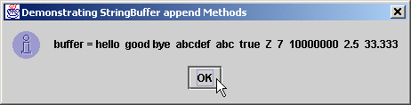
StringBufferAppend.java
Line 27
Line 29
Line 31
Lines 33-43
27 buffer.append( s );
28 buffer.append( " " );
29 buffer.append( charArray );
30 buffer.append( " " );
31 buffer.append( charArray, 0, 3 );
32 buffer.append( " " );
33 buffer.append( b );
34 buffer.append( " " );
35 buffer.append( c );
36 buffer.append( " " );
37 buffer.append( i );
38 buffer.append( " " );
39 buffer.append( l );
40 buffer.append( " " );
41 buffer.append( f );
42 buffer.append( " " );
43 buffer.append( d );
44
45 JOptionPane.showMessageDialog( null,
46 "buffer = " + buffer.toString(),
47 "Demonstrating StringBuffer append Methods",
48 JOptionPane.INFORMATION_MESSAGE );
49
50 System.exit( 0 );
51 }
52
53 } // end StringBufferAppend
Append String “good bye”
Append “a b c d e f”
Append “a b c”
Append boolean, char, int, long, float and double

Slide 49
10.18 StringBuffer Insertion and Deletion Methods
Method insert
  Allow data-type values to be inserted into StringBuffer
Methods delete and deleteCharAt
  Allow characters to be removed from StringBuffer

Slide 50
StringBufferInsert.java
1 // Fig. 10.16: StringBufferInsert.java
2 // This program demonstrates the insert and delete
3 // methods of class StringBuffer.
4
5 // Java extension packages
6 import javax.swing.*;
7
8 public class StringBufferInsert {
9
10 // test StringBuffer insert methods
11 public static void main( String args[] )
12 {
13 Object o = "hello";
14 String s = "good bye";
15 char charArray[] = { 'a', 'b', 'c', 'd', 'e', 'f' };
16 boolean b = true;
17 char c = 'K';
18 int i = 7;
19 long l = 10000000;
20 float f = 2.5f;
21 double d = 33.333;
22 StringBuffer buffer = new StringBuffer();
23

Slide 51
StringBufferInsert.java
Lines 24-40
Line 45
Line 46
24 buffer.insert( 0, o );
25 buffer.insert( 0, " " );
26 buffer.insert( 0, s );
27 buffer.insert( 0, " " );
28 buffer.insert( 0, charArray );
29 buffer.insert( 0, " " );
30 buffer.insert( 0, b );
31 buffer.insert( 0, " " );
32 buffer.insert( 0, c );
33 buffer.insert( 0, " " );
34 buffer.insert( 0, i );
35 buffer.insert( 0, " " );
36 buffer.insert( 0, l );
37 buffer.insert( 0, " " );
38 buffer.insert( 0, f );
39 buffer.insert( 0, " " );
40 buffer.insert( 0, d );
41
42 String output =
43 "buffer after inserts:\n" + buffer.toString();
44
45 buffer.deleteCharAt( 10 ); // delete 5 in 2.5
46 buffer.delete( 2, 6 ); // delete .333 in 33.333
47
48 output +=
49 "\n\nbuffer after deletes:\n" + buffer.toString();
50
51 JOptionPane.showMessageDialog( null, output,
52 "Demonstrating StringBufferer Inserts and Deletes",
53 JOptionPane.INFORMATION_MESSAGE );
54
55 System.exit( 0 );
56 }
57
58 } // end class StringBufferInsert
Use method insert to insert data types in beginning of StringBuffer
Use method deleteCharAt to remove character from index 10 in StringBuffer
Remove characters from indices 2 through 5 (inclusive)

Slide 52
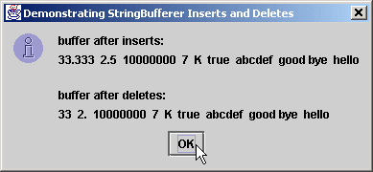
StringBufferInsert.java

Slide 53
10.19 Character Class Examples
Treat primitive variables as objects
  Type wrapper classes
    Boolean
    Character
    Double
    Float
    Byte
    Short
    Integer
    Long
  We examine class Character

Slide 54
StaticCharMethods.java
1 // Fig. 10.17: StaticCharMethods.java
2 // Demonstrates the static character testing methods
3 // and case conversion methods of class Character
4 // from the java.lang package.
5
6 // Java core packages
7 import java.awt.*;
8 import java.awt.event.*;
9
10 // Java extension packages
11 import javax.swing.*;
12
13 public class StaticCharMethods extends JFrame {
14 private char c;
15 private JLabel promptLabel;
16 private JTextField inputField;
17 private JTextArea outputArea;
18
19 // set up GUI
20 public StaticCharMethods()
21 {
22 super( "Static Character Methods" );
23
24 Container container = getContentPane();
25 container.setLayout( new FlowLayout() );
26
27 promptLabel =
28 new JLabel( "Enter a character and press Enter" );
29 container.add( promptLabel );
30
31 inputField = new JTextField( 5 );
32
33 inputField.addActionListener(
34

Slide 55
StaticCharMethods.java
35 // anonymous inner class
36 new ActionListener() {
37
38 // handle text field event
39 public void actionPerformed( ActionEvent event )
40 {
41 String s = event.getActionCommand();
42 c = s.charAt( 0 );
43 buildOutput();
44 }
45
46 } // end anonymous inner class
47
48 ); // end call to addActionListener
49
50 container.add( inputField );
51
52 outputArea = new JTextArea( 10, 20 );
53 container.add( outputArea );
54
55 setSize( 300, 250 ); // set the window size
56 show(); // show the window
57 }
58
59 // display character info in outputArea
60 public void buildOutput()
61 {

Slide 56
StaticCharMethods.java
Line 63
Line 66
Line 68
Line 69
Line 71
Lines 72-73
62 outputArea.setText(
63 "is defined: " + Character.isDefined( c ) +
64 "\nis digit: " + Character.isDigit( c ) +
65 "\nis Java letter: " +
66 Character.isJavaIdentifierStart( c ) +
67 "\nis Java letter or digit: " +
68 Character.isJavaIdentifierPart( c ) +
69 "\nis letter: " + Character.isLetter( c ) +
70 "\nis letter or digit: " +
71 Character.isLetterOrDigit( c ) +
72 "\nis lower case: " + Character.isLowerCase( c ) +
73 "\nis upper case: " + Character.isUpperCase( c ) +
74 "\nto upper case: " + Character.toUpperCase( c ) +
75 "\nto lower case: " + Character.toLowerCase( c ) );
76 }
77
78 // execute application
79 public static void main( String args[] )
80 {
81 StaticCharMethods application = new StaticCharMethods();
82
83 application.addWindowListener(
84
85 // anonymous inner class
86 new WindowAdapter() {
87
88 // handle event when user closes window
89 public void windowClosing( WindowEvent windowEvent )
90 {
91 System.exit( 0 );
92 }
Determine whether c is defined Unicode digit
Determine whether c can be used as first character in identifier
Determine whether c can be used as identifier character
Determine whether c is a letter
Determine whether c is letter or digit
Determine whether c is uppercase or lowercase

Slide 57
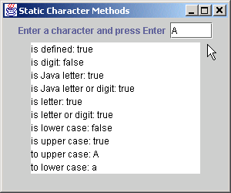
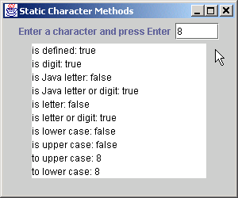

StaticCharMethods.java
93
94 } // end anonymous inner class
95
96 ); // end call to addWindowListener
97
98 } // end method main
99
100 } // end class StaticCharMethods

Slide 58
StaticCharMethods2.java
1 // Fig. 10.18: StaticCharMethods2.java
2 // Demonstrates the static character conversion methods
3 // of class Character from the java.lang package.
4
5 // Java core packages
6 import java.awt.*;
7 import java.awt.event.*;
8
9 // Java extension packages
10 import javax.swing.*;
11
12 public class StaticCharMethods2 extends JFrame {
13 private char c;
14 private int digit, radix;
15 private JLabel prompt1, prompt2;
16 private JTextField input, radixField;
17 private JButton toChar, toInt;
18
19 public StaticCharMethods2()
20 {
21 super( "Character Conversion Methods" );
22
23 // set up GUI and event handling
24 Container container = getContentPane();
25 container.setLayout( new FlowLayout() );
26
27 prompt1 = new JLabel( "Enter a digit or character " );
28 input = new JTextField( 5 );
29 container.add( prompt1 );
30 container.add( input );
31
32 prompt2 = new JLabel( "Enter a radix " );
33 radixField = new JTextField( 5 );
34 container.add( prompt2 );
35 container.add( radixField );

Slide 59
StaticCharMethods2.java
36
37 toChar = new JButton( "Convert digit to character" );
38
39 toChar.addActionListener(
40
41 // anonymous inner class
42 new ActionListener() {
43
44 // handle toChar JButton event
45 public void actionPerformed( ActionEvent actionEvent )
46 {
47 digit = Integer.parseInt( input.getText() );
48 radix =
49 Integer.parseInt( radixField.getText() );
50 JOptionPane.showMessageDialog( null,
51 "Convert digit to character: " +
52 Character.forDigit( digit, radix ) );
53 }
54
55 } // end anonymous inner class
56
57 ); // end call to addActionListener
58
59 container.add( toChar );
60
61 toInt = new JButton( "Convert character to digit" );
62
63 toInt.addActionListener(
64
65 // anonymous inner class
66 new ActionListener() {
67
Use method forDigit to convert int digit to number-system character specified by int radix

Slide 60
StaticCharMethods2.java
Line 77
68 // handle toInt JButton event
69 public void actionPerformed( ActionEvent actionEvent )
70 {
71 String s = input.getText();
72 c = s.charAt( 0 );
73 radix =
74 Integer.parseInt( radixField.getText() );
75 JOptionPane.showMessageDialog( null,
76 "Convert character to digit: " +
77 Character.digit( c, radix ) );
78 }
79
80 } // end anonymous inner class
81
82 ); // end call to addActionListener
83
84 container.add( toInt );
85
86 setSize( 275, 150 ); // set the window size
87 show(); // show the window
88 }
89
90 // execute application
91 public static void main( String args[] )
92 {
93 StaticCharMethods2 application = new StaticCharMethods2();
94
95 application.addWindowListener(
96
97 // anonymous inner class
98 new WindowAdapter() {
99
Use method digit to convert char c to number-system integer specified by int radix

Slide 61
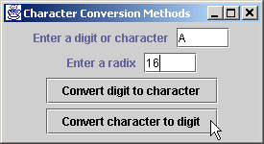
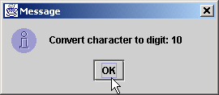
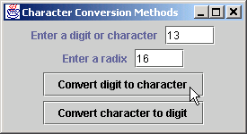
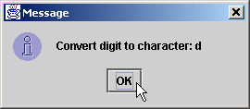
StaticCharMethods2.java
100 // handle event when user closes window
101 public void windowClosing( WindowEvent windowEvent )
102 {
103 System.exit( 0 );
104 }
105
106 } // end anonymous inner class
107
108 ); // end call to addWindowListener
109
110 } // end method main
111
112 } // end class StaticCharMethods2

Slide 62
OtherCharMethods.java
Lines 18-23
1 // Fig. 10.19: OtherCharMethods.java
2 // Demonstrate the non-static methods of class
3 // Character from the java.lang package.
4
5 // Java extension packages
6 import javax.swing.*;
7
8 public class OtherCharMethods {
9
10 // test non-static Character methods
11 public static void main( String args[] )
12 {
13 Character c1, c2;
14
15 c1 = new Character( 'A' );
16 c2 = new Character( 'a' );
17
18 String output = "c1 = " + c1.charValue() +
19 "\nc2 = " + c2.toString() +
20 "\n\nhash code for c1 = " + c1.hashCode() +
21 "\nhash code for c2 = " + c2.hashCode();
22
23 if ( c1.equals( c2 ) )
24 output += "\n\nc1 and c2 are equal";
25 else
26 output += "\n\nc1 and c2 are not equal";
27
28 JOptionPane.showMessageDialog( null, output,
29 "Demonstrating Non-Static Character Methods",
30 JOptionPane.INFORMATION_MESSAGE );
31
32 System.exit( 0 );
33 }
34
35 } // end class OtherCharMethods
Characters non-static methods charValue, toString, hashCode and equals

Slide 63
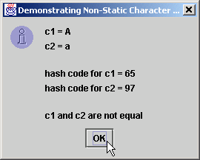
OtherCharMethods.java

Slide 64
10.20 Class StringTokenizer
Tokenizer
  Partition String into individual substrings
  Use delimiter
  Java offers java.util.StringTokenizer

Slide 65
TokenTest.java
Line 29
1 // Fig. 10.20: TokenTest.java
2 // Testing the StringTokenizer class of the java.util package
3
4 // Java core packages
5 import java.util.*;
6 import java.awt.*;
7 import java.awt.event.*;
8
9 // Java extension packages
10 import javax.swing.*;
11
12 public class TokenTest extends JFrame {
13 private JLabel promptLabel;
14 private JTextField inputField;
15 private JTextArea outputArea;
16
17 // set up GUI and event handling
18 public TokenTest()
19 {
20 super( "Testing Class StringTokenizer" );
21
22 Container container = getContentPane();
23 container.setLayout( new FlowLayout() );
24
25 promptLabel =
26 new JLabel( "Enter a sentence and press Enter" );
27 container.add( promptLabel );
28
29 inputField = new JTextField( 20 );
30
31 inputField.addActionListener(
32
33 // anonymous inner class
34 new ActionListener() {
35
inputField contains String to be parsed by StringTokenizer

Slide 66
TokenTest.java
Lines 41-42
Line 45
Lines 47-48
36 // handle text field event
37 public void actionPerformed( ActionEvent event )
38 {
39 String stringToTokenize =
40 event.getActionCommand();
41 StringTokenizer tokens =
42 new StringTokenizer( stringToTokenize );
43
44 outputArea.setText( "Number of elements: " +
45 tokens.countTokens() + "\nThe tokens are:\n" );
46
47 while ( tokens.hasMoreTokens() )
48 outputArea.append( tokens.nextToken() + "\n" );
49 }
50
51 } // end anonymous inner class
52
53 ); // end call to addActionListener
54
55 container.add( inputField );
56
57 outputArea = new JTextArea( 10, 20 );
58 outputArea.setEditable( false );
59 container.add( new JScrollPane( outputArea ) );
60
61 setSize( 275, 260 ); // set the window size
62 show(); // show the window
63 }
64
65 // execute application
66 public static void main( String args[] )
67 {
68 TokenTest application = new TokenTest();
69
Use StringTokenizer to parse String stringToTokenize with default delimiter “ \n\t\r”
Count number of tokens
Append next token to outputArea, as long as tokens exist

Slide 67
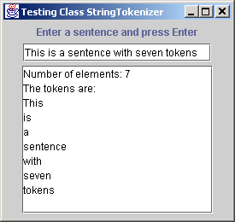
TokenTest.java
70 application.addWindowListener(
71
72 // anonymous inner class
73 new WindowAdapter() {
74
75 // handle event when user closes window
76 public void windowClosing( WindowEvent windowEvent )
77 {
78 System.exit( 0 );
79 }
80
81 } // end anonymous inner class
82
83 ); // end call to addWindowListener
84
85 } // end method main
86
87 } // end class TokenTest

Slide 68
10.21 Card Shuffling and Dealing Simulation
Develop DeckOfCards application
  Create deck of 52 playing cards using Card objects
  User deals card by clicking “Deal card” button
  User shuffles deck by clicking “Shuffle cards” button
  Use random-number generation

Slide 69
DeckOfCards.java
Lines 19 and 29
Line 30
Lines 33-35
1 // Fig. 10.21: DeckOfCards.java
2 // Card shuffling and dealing program
3
4 // Java core packages
5 import java.awt.*;
6 import java.awt.event.*;
7
8 // Java extension packages
9 import javax.swing.*;
10
11 public class DeckOfCards extends JFrame {
12 private Card deck[];
13 private int currentCard;
14 private JButton dealButton, shuffleButton;
15 private JTextField displayField;
16 private JLabel statusLabel;
17
18 // set up deck of cards and GUI
19 public DeckOfCards()
20 {
21 super( "Card Dealing Program" );
22
23 String faces[] = { "Ace", "Deuce", "Three", "Four",
24 "Five", "Six", "Seven", "Eight", "Nine", "Ten",
25 "Jack", "Queen", "King" };
26 String suits[] =
27 { "Hearts", "Diamonds", "Clubs", "Spades" };
28
29 deck = new Card[ 52 ];
30 currentCard = -1;
31
32 // populate deck with Card objects
33 for ( int count = 0; count < deck.length; count++ )
34 deck[ count ] = new Card( faces[ count % 13 ],
35 suits[ count / 13 ] );
Deck of 52 Cards
Most recently dealt Cards in deck array (-1 if not Cards have been dealt)
Fill deck array with Cards

Slide 70
DeckOfCards.java
Line 50
Line 53
36
37 // set up GUI and event handling
38 Container container = getContentPane();
39 container.setLayout( new FlowLayout() );
40
41 dealButton = new JButton( "Deal card" );
42 dealButton.addActionListener(
43
44 // anonymous inner class
45 new ActionListener() {
46
47 // deal one card
48 public void actionPerformed( ActionEvent actionEvent )
49 {
50 Card dealt = dealCard();
51
52 if ( dealt != null ) {
53 displayField.setText( dealt.toString() );
54 statusLabel.setText( "Card #: " + currentCard );
55 }
56 else {
57 displayField.setText(
58 "NO MORE CARDS TO DEAL" );
59 statusLabel.setText(
60 "Shuffle cards to continue" );
61 }
62 }
63
64 } // end anonymous inner class
65
66 ); // end call to addActionListener
67
68 container.add( dealButton );
69
When user presses Deal Card button, method dealCard gets next card in deck array
Display Card in JTextField

Slide 71
DeckOfCards.java
Line 80
70 shuffleButton = new JButton( "Shuffle cards" );
71 shuffleButton.addActionListener(
72
73 // anonymous inner class
74 new ActionListener() {
75
76 // shuffle deck
77 public void actionPerformed( ActionEvent actionEvent )
78 {
79 displayField.setText( "SHUFFLING ..." );
80 shuffle();
81 displayField.setText( "DECK IS SHUFFLED" );
82 }
83
84 } // end anonymous inner class
85
86 ); // end call to addActionListener
87
88 container.add( shuffleButton );
89
90 displayField = new JTextField( 20 );
91 displayField.setEditable( false );
92 container.add( displayField );
93
94 statusLabel = new JLabel();
95 container.add( statusLabel );
96
97 setSize( 275, 120 ); // set window size
98 show(); // show window
99 }
100
When user presses Shuffle Cards button, method shuffle shuffles cards

Slide 72
DeckOfCards.java
Lines 102-115
Lines 118-126
Lines 114 and 123
101 // shuffle deck of cards with one-pass algorithm
102 public void shuffle()
103 {
104 currentCard = -1;
105
106 // for each card, pick another random card and swap them
107 for ( int first = 0; first < deck.length; first++ ) {
108 int second = ( int ) ( Math.random() * 52 );
109 Card temp = deck[ first ];
110 deck[ first ] = deck[ second ];
111 deck[ second ] = temp;
112 }
113
114 dealButton.setEnabled( true );
115 }
116
117 // deal one card
118 public Card dealCard()
119 {
120 if ( ++currentCard < deck.length )
121 return deck[ currentCard ];
122 else {
123 dealButton.setEnabled( false );
124 return null;
125 }
126 }
127
128 // execute application
129 public static void main( String args[] )
130 {
131 DeckOfCards app = new DeckOfCards();
132
133 app.addWindowListener(
134
Shuffle cards by swapping each Card with randomly selected Card
If deck is not empty, a Card object reference is returned; otherwise, null is returned
Method setEnabled enables and disables JButton

Slide 73
DeckOfCards.java
Lines 154-155
135 // anonymous inner class
136 new WindowAdapter() {
137
138 // terminate application when user closes window
139 public void windowClosing( WindowEvent windowEvent )
140 {
141 System.exit( 0 );
142 }
143
144 } // end anonymous inner class
145
146 ); // end call to addWindowListener
147
148 } // end method main
149
150 } // end class DeckOfCards
151
152 // class to represent a card
153 class Card {
154 private String face;
155 private String suit;
156
157 // constructor to initialize a card
158 public Card( String cardFace, String cardSuit )
159 {
160 face = cardFace;
161 suit = cardSuit;
162 }
163
Store face name and suit for specific Card, respectively

Slide 74
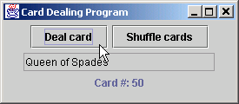
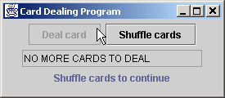
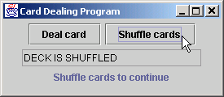

DeckOfCards.java
164 // return String represenation of Card
165 public String toString()
166 {
167 return face + " of " + suit;
168 }
169
170 } // end class Card

Slide 75
10.22 (Optional Case Study) Thinking About Objects: Event Handling
How objects interact
  Sending object sends message to receiving object
  We discuss how elevator-system objects interact
    Model system behavior

Slide 76
10.22 Thinking About Objects (cont.)
Event
  Message that notifies an object of an action
    Action: Elevator arrives at Floor
    Consequence: Elevator sends elevatorArrived event to Elevator’s Door
      i.e., Door is “notified” that Elevator has arrived
    Action: Elevator’s Door opens
    Consequence: Door sends doorOpened event to Person
      i.e., Person is “notified” that Door has opened
  Preferred naming structure
    Noun (“elevator”) preceded by verb (“arrived”)

Slide 77
ElevatorModelEvent.java
Line 8
Line 11
Line 14
1 // ElevatorModelEvent.java
2 // Basic event packet holding Location object
3 package com.deitel.jhtp4.elevator.event;
4
5 // Deitel packages
6 import com.deitel.jhtp4.elevator.model.*;
7
8 public class ElevatorModelEvent {
9
10 // Location that generated ElevatorModelEvent
11 private Location location;
12
13 // source of generated ElevatorModelEvent
14 private Object source;
15
16 // ElevatorModelEvent constructor sets Location
17 public ElevatorModelEvent( Object source,
18 Location location )
19 {
20 setSource( source );
21 setLocation( location );
22 }
23
24 // set ElevatorModelEvent Location
25 public void setLocation( Location eventLocation )
26 {
27 location = eventLocation;
28 }
29
30 // get ElevatorModelEvent Location
31 public Location getLocation()
32 {
33 return location;
34 }
35
Represents an event in elevator simulation
Location object reference represents location where even was generated
Object object reference represents object that generated event

Slide 78
ElevatorModelEvent.java
36 // set ElevatorModelEvent source
37 private void setSource( Object eventSource )
38 {
39 source = eventSource;
40 }
41
42 // get ElevatorModelEvent source
43 public Object getSource()
44 {
45 return source;
46 }
47 }

Slide 79
10.22 Thinking About Objects (cont.)
Every object sends ElevatorModelEvent
  This may become confusing
    Door sends ElevatorModelEvent to Person upon opening
    Elevator sends ElevatorModelEvent to Door upon arrival
  Solution:
    Create several ElevatorModelEvent subclasses
      Each subclass better represents action
      e.g., BellEvent when Bell rings

Slide 80
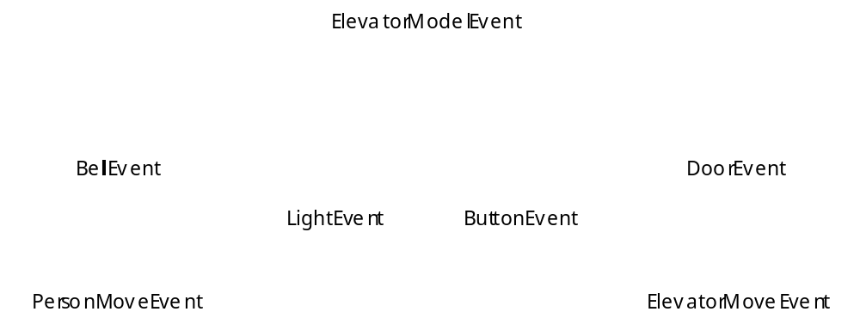
Fig. 10.23 Class diagram that models the generalization between ElevatorModelEvent and its subclasses.

Slide 81
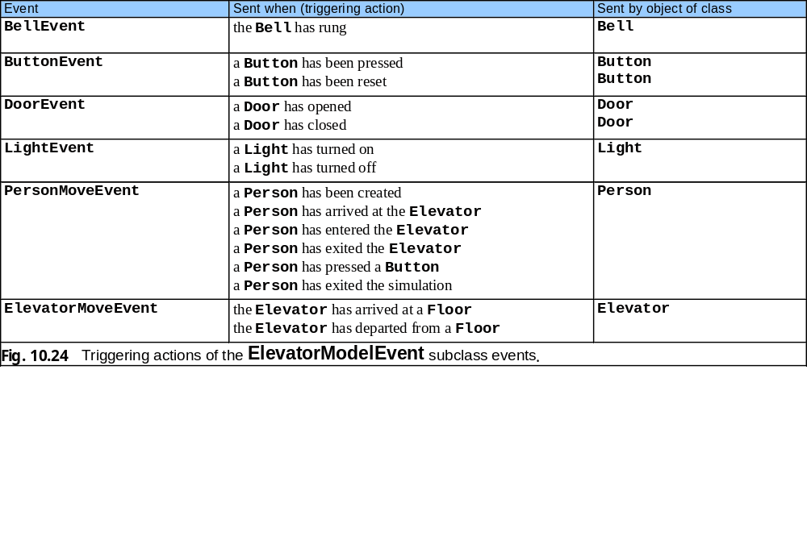
Fig. 10.24 Triggering actions of the ElevatorModelEvent subclass events.

Slide 82
10.22 Thinking About Objects (cont.)
Event handling
  Similar to collaboration
  Object sends message (event) to objects
    However, receiving objects must be listening for event
      Called event listeners
  Listeners must register with sender to receive event

Slide 83
10.22 Thinking About Objects (cont.)
Modify collaboration diagram of Fig. 7.20
  Incorporate event handling (Fig. 10.25)
  Three changes
    Include notes
      Explanatory remarks about UML graphics
      Represented as rectangles with corners “folded over”
    All interactions happen on first Floor
      Eliminates naming ambiguity
    Include events
      Elevator informs objects of action that has happened
        Elevator notifies object of arrival

Slide 84
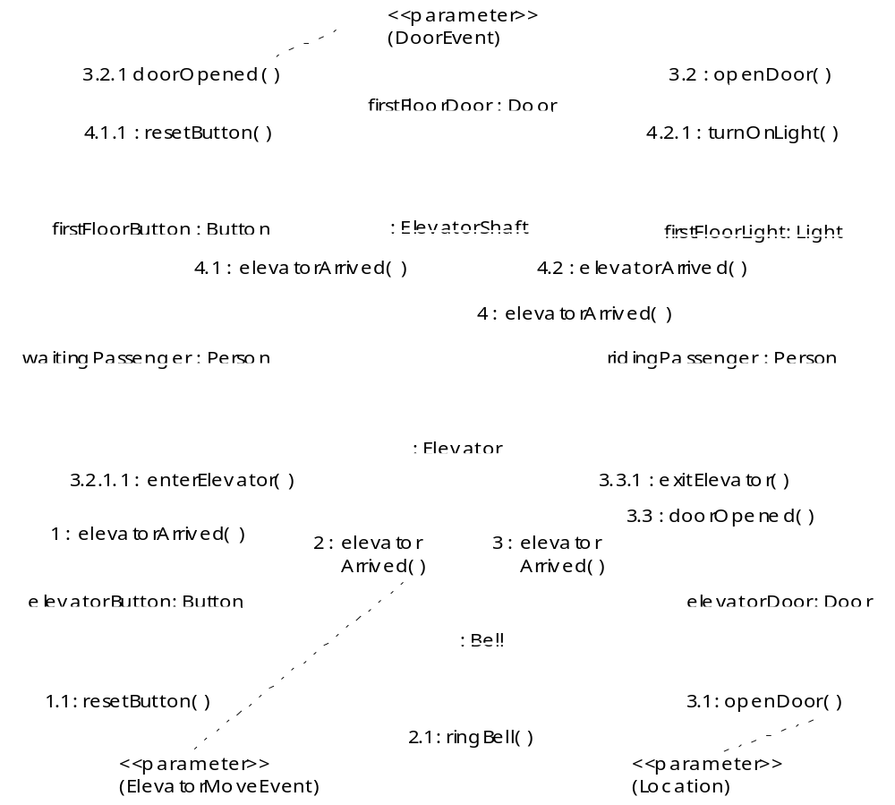
Fig. 10.25 Modified collaboration diagram for passengers entering and exiting the Elevator on the first Floor.

Slide 85
10.22 Thinking About Objects (cont.)
Event listeners
  Elevator sends ElevatorMoveEvent
    All event classes (in our simulation) have this structure
  Door must implement interface that “listens” for this event
  Door implements interface ElevatorMoveListener
    Method elevatorArrived
      Invoked when Elevator arrives
    Method elevatorDeparted
      Invoked when Elevator departs

Slide 86
ElevatorMoveEvent.java
1 // ElevatorMoveEvent.java
2 // Indicates on which Floor the Elevator arrived or departed
3 package com.deitel.jhtp4.elevator.event;
4
5 // Deitel package
6 import com.deitel.jhtp4.elevator.model.*;
7
8 public class ElevatorMoveEvent extends ElevatorModelEvent {
9
10 // ElevatorMoveEvent constructor
11 public ElevatorMoveEvent( Object source, Location location )
12 {
13 super( source, location );
14 }
15 }

Slide 87
ElevatorMoveListener.java
1 // ElevatorMoveListener.java
2 // Methods invoked when Elevator has either departed or arrived
3 package com.deitel.jhtp4.elevator.event;
4
5 public interface ElevatorMoveListener {
6
7 // invoked when Elevator has departed
8 public void elevatorDeparted( ElevatorMoveEvent moveEvent );
9
10 // invoked when Elevator has arrived
11 public void elevatorArrived( ElevatorMoveEvent moveEvent );
12 }

Slide 88
10.22 Thinking About Objects (cont.)
Class diagram revisited
  Modify class diagram of Fig. 9.19 to include
    Signals (events)
      e.g., Elevator signals arrival to Light
    Self associations
      e.g., Light turns itself on and off

Slide 89
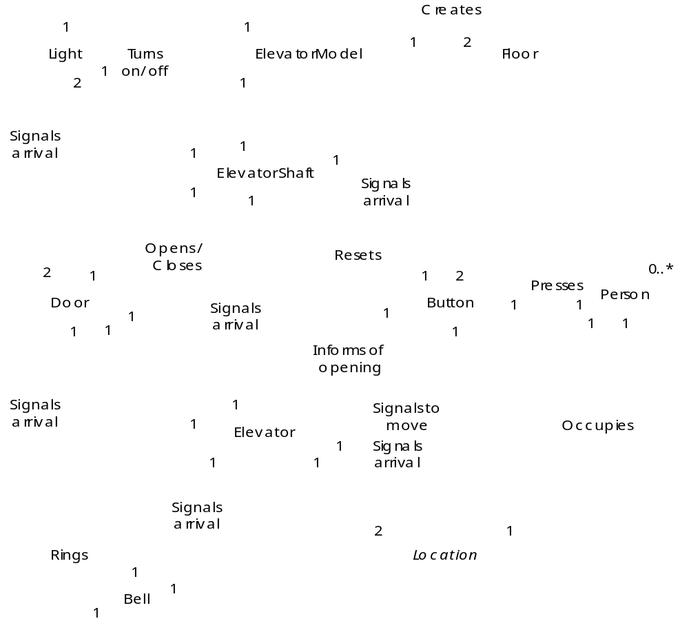
Fig. 10.28 Class diagram of our simulator (including event handling).

